Slide 1

CSE 464 : Software Quality Assurance and Testing
Analysis of BVA, EP, and DT
(Strengths Limitations and Applicability)
Janaka Balasooriya

Slide 2
Last Lecture: Decision Table
• Originally known as Cause and Effect Graphing
  – Done with a graphical technique that expressed AND-OR-NOT logic.
  – Causes and Effects were graphed like circuit components
  – Inputs to a circuit “caused” outputs (effects)
• Equivalent to forming a decision table in which:
  – inputs are conditions
  – outputs are actions
• Test every (possible) rule in the decision table.
• Recommended for logically complex situations.

Slide 3
When Decision Tables Do Not Work?
Well When…
• The order of inputs is important.
• Time duration of input events is important.
• Times at which inputs occur is important.
Special Considerations are needed When…
Conditions are mutually exclusive.
There are many conditions. (n boolean conditions determine a table with 2^n rules!)

Slide 4
Retrospective on Boundary Value (BVA), Equivalent Partitioning (EP), and Decision Table (DT) Techniques
• Test case development effort
• Test case effectiveness
• Test method selection guidelines

Slide 5
The Test Method Pendulum

Slide 6
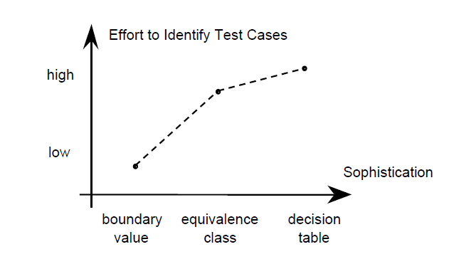
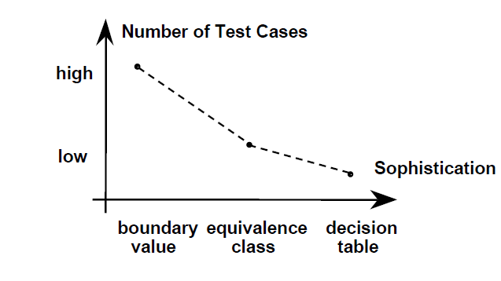
Test case development effort
• Boundary value: almost mechanical
• Equivalence class: some effort to identify classes
• Decision table: still more effort

Slide 7
Test Case Effectiveness
• True trade-off between development effort and number of test cases.
• Vulnerabilities
  – Boundary value testing has gaps and redundancies, and many test cases.
  – Equivalence class testing eliminates the gaps and redundancies, but cannot deal with dependencies among variables.
  – Decision table testing extends equivalence class testing by dealing with dependencies, and supports algebraic reduction of test cases.
  So, we need to apply these techniques in mix in most of the situation. See Triangle problem solution.

Slide 8
Triangle Problem Analysis
Triangle Problem
Decision Table Based
Test Cases : 14
Logic path coverage : 28/28
Equivalent Partitions
Weak Robust + Strong Normal
Test cases = 10
Logic Path Coverage = 24/28
Weak Robust + Strong Normal + BV
Test cases = 23
Logic Path Coverage = 28/28
Conclusion
More dependencies among inputs (Triangle inequality in addition to valid and invalid). DT is good at covering such dependencies
Note: These numbers are from the code coverage of triangle Junit test cases

Slide 9
Limitations of BVA, EP, and DT
Program Behaviors :
In general, software can be classified into two possible groups: stateless and state-oriented.
Actions of state-oriented systems depend on the previous inputs/outputs of the system.
So, in a situation where the system is state-oriented, we need to have a way to model the behavior of the system.
Several behavior modeling approaches are being used in software testing : FSM (Finite State Model), Petri-Net, and StateCharts are more common

Slide 10
Limitations of BVA, EP, and DT
Common System Behavior Models
Behavior | Decision Table | Finite State Machine (FSM) | Petri-Net
Sequence | No | Yes | Yes
Selection | Yes | Yes | Yes
Repetition | No | Yes | Yes
Multiple-causes of output | Yes | Yes | Yes
Mutual Exclusion | No | No | Yes
Concurrency | No | No | Yes
Deadlock | No | No | Yes

Slide 11
Concurrency, Mutual Exclusion, and Deadlocks
Mutual Exclusion
file sharing by reading and writing processes
OS interrupt handling
if lock is not set
then set the lock
enter critical section ...
leave critical section
unset the lock
P1
P2
R1
R2
Deadlock Situation

Slide 12
Next Time
Model Based Testing

